Slide 1
Introduction to Data Structure and Algorithm
Dr. Shatarupa dash

Slide 2
Data Structure
Data: facts and statistics collected together for reference or analysis.
Structure: it’s a container where you can store data.

Slide 3
What is Data Structure?
Data structure is a representation of data and the operations allowed on that data.
A data structure is a way to store and organize data in order to facilitate the access and modifications.
Data Structure are the method of representing of logical relationships between individual data elements related to the solution of a given problem.

Slide 4
Data Structure in Abstract…
Storage of Data
Accessing Data
Operations perform on Data

Slide 5
Real life Example of Data Structure
Hanging clothes in your cupboard
Shoes arranged in rack.
Stacking of plates
Dictionary look up
Locating city in Map
Searching phone number in phone directory

Slide 6
Why we need different Data Structure?
No single data structure works well for all purposes, and so it is important to know the strengths and limitations of several of them.

Slide 7
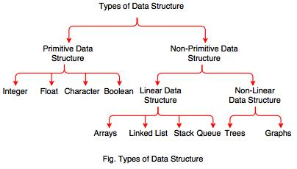
Basic Data Structure{Broadly}

Slide 8
Basic Data Structure{Narrow Down}
Basic Data Structures
Linear Data Structures
Non-Linear Data Structures
Arrays
Linked Lists
Stacks
Queues
Trees
Graphs
Hash Tables

Slide 9
array
Linked list
queue
tree
stack

Slide 10
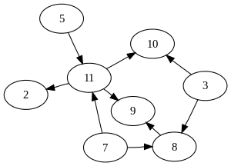
Graph

Slide 11
Selection of Data Structure
The choice of particular data model depends on two consideration:
It must be rich enough in structure to represent the relationship between data elements
The structure should be simple enough that one can effectively process the data when necessary

Slide 12
Types of Data Structure
Linear: In Linear data structure, values are arrange in linear fashion.
Array: Fixed-size
Linked-list: Variable-size
Stack: Add to top and remove from top
Queue: Add to back and remove from front

Slide 13
Types of Data Structure
Non-Linear: The data values in this structure are not arranged in order.
Hash tables: Unordered lists which use a ‘hash function’ to insert and search
Tree: Data is organized in branches.
Graph: A more general branching structure, with less strict connection conditions than for a tree

Slide 14
Type of Data Structures
Homogenous: In this type of data structures, values of the same types of data are stored.
Array
Non-Homogenous: In this type of data structures, data values of different types are grouped and stored.
Structures
Classes

Slide 15
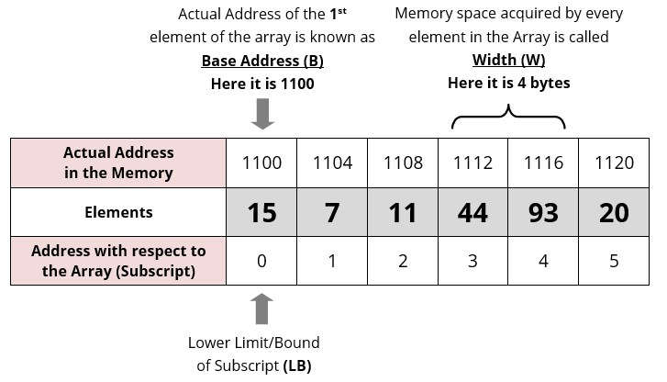
Array

Slide 16
List
A Flexible structure, because can grow and shrink on demand.
Elements can be:
Inserted
Accessed
Deleted
At any position
last
head

Slide 17
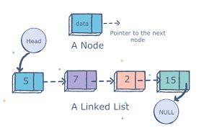
List

Slide 18
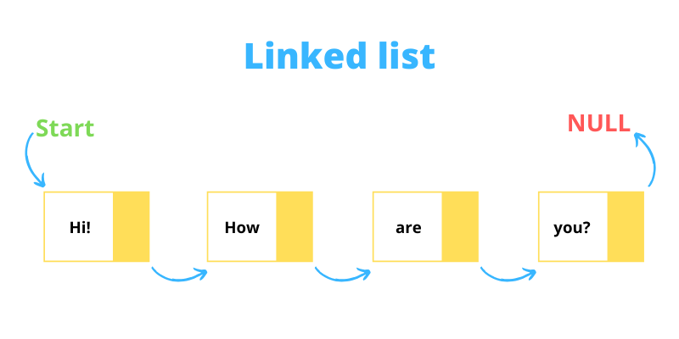
List

Slide 19
Stacks
Collection with access only to the last element inserted
Last in first out
Insert/push
Delete/pop
Top
Data4
Top
Data3
Data2
Data1

Slide 20
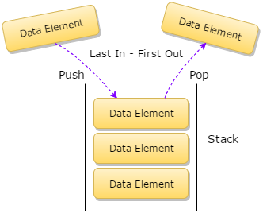
Stacks

Slide 21
Queues
Last in last out or first in first out(FIFO)
Enqueue at Rear
Dequeue at Front
Front
Rear
Data1
Data2
Data3
Data4

Slide 22
Tree
Root

Slide 23
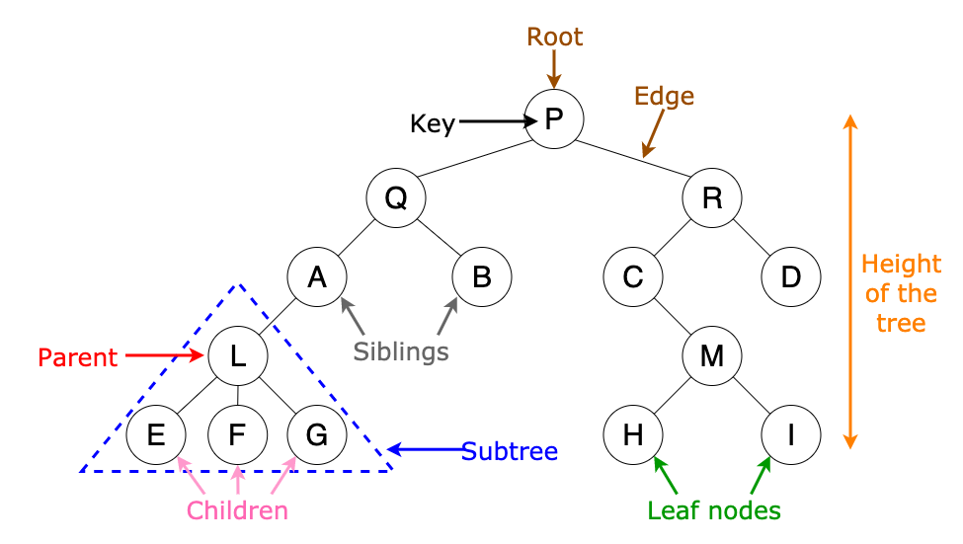
Tree
A Tree is a collection of elements called nodes.
One of the node is distinguished as a roott, along with a relation (“parenthood”) that places a hierarchical structure on the nodes.

Slide 24
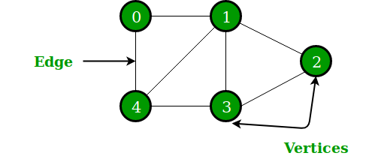
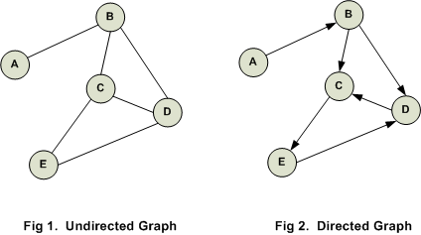
Graph
A Graph is a non-linear data structure consisting of nodes/vartices and edges

Slide 25
Algorithm
Algorithm is a step by step procedure which define set of instruction to be executed in certain order to get output.

Slide 26
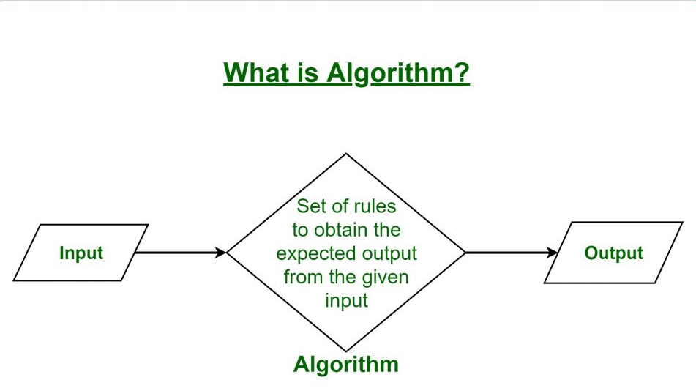

Slide 27
What are the Characteristics of an Algorithm?

Slide 28
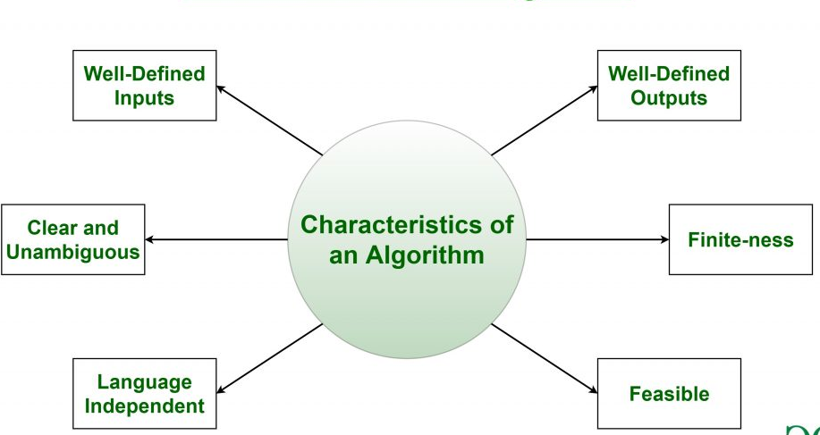

Slide 29
Characteristics of an Algorithm
Clear and Unambiguous: Algorithm should be clear and unambiguous. Each of its steps should be clear in all aspects and must lead to only one meaning.
Well-Defined Inputs: If an algorithm says to take inputs, it should be well-defined inputs.
Well-Defined Outputs: The algorithm must clearly define what output will be yielded and it should be well-defined as well.

Slide 30
Characteristics of an Algorithm
Finite-ness: The algorithm must be finite, i.e. it should not end up in an infinite loops or similar.
Feasible: The algorithm must be simple, generic and practical, such that it can be executed upon will the available resources. It must not contain some future technology, or anything.
Language Independent: The Algorithm designed must be language-independent, i.e. it must be just plain instructions that can be implemented in any language, and yet the output will be same, as expected.

Slide 31
Lets see Example
Algorithm to MULTIPLY 2 numbers and print their MUL:
START
Declare 2 integer variables DATA1, DATA2.
Take the 2 numbers, to be MUL, as inputs in variables DATA1, DATA2.
Declare an integer variable MUL to store the RESULT of MULTIPLICATION.
MULTIPLY 2 numbers and store the result in the variable MUL.
Print the value of variable MUL.
END

Slide 32
Standard Algorithm should be good and must be Efficient.

Slide 33
How to Analyze an Algorithm?

Slide 34
Priori Analysis
“Priori” means “before”.
Checking the algorithm before its implementation.
Algorithm is checked when it is written in the form of theoretical steps.
Efficiency of an algorithm is measured by assuming that all other factors like processor speed.

Slide 35
Posterior Analysis:
“Posterior” means “after”.
Posterior analysis means checking the algorithm after its implementation.
Algorithm is checked by implementing it in any programming language and executing it.
This analysis helps to get the actual and real analysis report about correctness, space required, time consumed etc.

Slide 36
Complexity of algorithm
An algorithm is defined as complex based on the amount of Space and Time it consumes.

Slide 37
Factors of Algorithm Complexity
Time Factor: Time is measured by counting the number of key operations such as comparisons in the sorting algorithm.
Space Factor: Space is measured by counting the maximum memory space required by the algorithm.

Slide 38
Empirical analysis
Theoretical analysis does not give much of an idea of how well a given algorithm will perform in a specific situation.
So……..lets move to mathematical analysis of algorithm
Principal alternative to the mathmatical analysis of an algorithms efficiency called empirical analysis.

Slide 39
Empirical analysis
Empirical analysis to verify and expand on the theoretical analysis of an algorithm
• understand the theoretical analysis
• decide on what should be measured
• decide on appropriate hardware
• decide on appropriate data structures

Slide 40
Empirical analysis
• Decide on an appropriate implementation language and implement the algorithms
• Implement some form of timing device
• Create the input data sets necessary to produce the measurements we need.

Slide 41
Empirical analysis
• Measure the performance of the algorithm on the different input data sets created to meet our aim
• Interpret the results and relate them to the theoretical
analysis

Slide 42
Seven common function used in Algorithm Study
Constant Function:
simplest function we can think of is the constant function, that is, f (n) = c, for some fixed constant c, such as c = 5, c = 27, or c = 210.
It does not matter what the value of n is; f (n) will always be equal to the constant value c.

Slide 43
Logarithm Function
f (n) = logb n, for some constant b > 1
function is defined as the inverse of a power, as follows: x = logb n if and only if b^{x} = n.
b is known as the base of the logarithm. Note that by the above definition, for any base b > 0, we have that logb 1 = 0.

Slide 44
Logarithm Function
Proposition 4.1 (Logarithm Rules): Given real numbers a > 0, b > 1, c > 0, and d > 1, we have: 1. logb(ac) = logb a+logb c 2. logb(a/c) = logb a - logb c 3. logb(ac) = clogb a 4. logb a = logd a/logd b 5. blogd a = alogd b

Slide 45
The Linear Function
Another simple yet important function is the linear function, f (n) = n.
That is, given an input value n, the linear function f assigns the value n itself.
This function arises in algorithm analysis any time we have to do a single basic operation for each of n elements. For example, comparing a number x to each element of an array of size n will require n comparisons.

Slide 46
N-Log-N Function
f (n) = nlog n
It is the function that assigns to an input n the value of n times the logarithm base-two of n.
This function grows a little more rapidly than the linear function and a lot less rapidly than the quadratic function.

Slide 47
The Quadratic Function
Another function that appears often is the quadratic function, f (n) = n². ( given an input value n, the function f assigns the product of n with itself)
The main reason why the quadratic function appears in the analysis of algorithms is that there are many algorithms that have nested loops, where the inner loop performs a linear number of operations and the outer loop is performed a linear number of times.

Slide 48
The Cubic Function and Other Polynomials
Cubic function
f(n) = n³
input value n the product of n with itself three times. The cubic function appears less frequently in the context of algorithm analysis.

Slide 49

Polynomials
The linear, quadratic and cubic functions can each be viewed as being part of a larger class of functions, the polynomials.
A polynomial function has the form:
where a₀,a₁,...,a_{d} are constants, called the coefficients of the polynomial
Integer d, which indicates the highest power in the polynomial, is called the degree of the polynomial

Slide 50

Exponential Function
Another function used in the analysis of algorithms is the exponential function, f(n) = b^{n}, where b is a positive constant, called the base, and the argument n is the exponent. Proposition 4.4 (Exponent Rules): Given positive integers a, b, and c, we have

Slide 51
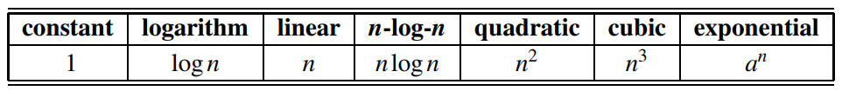
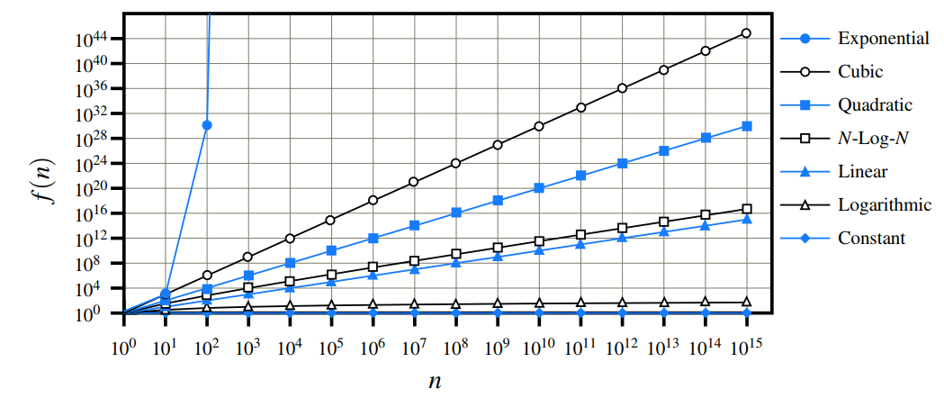
Comparing Growth Rates

Slide 52
Asymptotic Notation

Slide 53
Algorithm Complexity
Worst Case Complexity:
the function defined by the maximum number of steps taken on any instance of size n
Best Case Complexity:
the function defined by the minimum number of steps taken on any instance of size n
Average Case Complexity:
the function defined by the average number of steps taken on any instance of size n

Slide 54
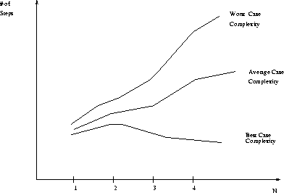
Best, Worst, and Average Case Complexity
Number of steps
Worst Case Complexity
Average Case Complexity
Best Case Complexity
N
(input size)

Slide 55
Try your own Analysis
It’s hard to estimate the running time exactly
Best case depends on the input
Average case is difficult to compute
So we usually focus on worst case analysis
Easier to compute
Usually close to the actual running time
Strategy: find a function (an equation) that, for large n, is an upper bound to the actual function (actual number of steps, memory usage, etc.)
Notes:
5 is a lower bound for the set { 5, 10, 34, 13934 }, but 8 is not. 42 is both an upper and a lower bound for the set { 42 }; all other numbers are either an upper bound or a lower bound for that set.

Slide 56
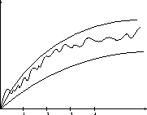
Analysis continue………………….
Upper bound
Actual function
Lower bound

Slide 57
Motivation for Asymptotic Analysis
An exact computation of worst-case running time can be difficult
Function may have many terms:
4n² - 3n log n + 17.5 n - 43 n^{⅔} + 75
An exact computation of worst-case running time is unnecessary
Remember that we are already approximating running time by using RAM model
Notes:
Random Access Machine (RAM) model. This model assumes a single processor. In the RAM model, instructions are executed one after the other, with no concurrent operations. This model of computation is an abstraction that allows us to compare algorithms on the basis of performance. The assumptions made in the RAM model to accomplish this are:
Each simple operation takes 1 time step.
Loops and subroutines are not simple operations.
Each memory access takes one time step, and there is no shortage of memory.

Slide 58
Classifying functions by their Asymptotic Growth Rates (1/2)
asymptotic growth rate, asymptotic order, or order of functions
Comparing and classifying functions that ignores
constant factors and
small inputs.
The Sets big oh O(g), big theta Θ(g), big omega Ω(g)

Slide 59
Classifying functions by their Asymptotic Growth Rates (2/2)
O(g(n)), Big-Oh of g of n, the Asymptotic Upper Bound;
Θ(g(n)), Theta of g of n, the Asymptotic Tight Bound; and
Ω(g(n)), Omega of g of n, the Asymptotic Lower Bound.
Notes:
asymptotically tight bound: Definition: When the asymptotic complexity of an algorithm exactly matches the theoretically proved asymptotic complexity of the corresponding problem. Informally, when an algorithm solves a problem at the theoretical minimum.

Slide 60
Big O Notation

Slide 61
Big-O
What does it mean?
If f(n) = O(n²), then:
f(n) can be larger than n² sometimes, but…
We can choose some constant c and some value n₀ such that for every value of n larger than n₀ : f(n) < cn²
That is, for values larger than n₀, f(n) is never more than a constant multiplier greater than n²
Or, in other words, f(n) does not grow more than a constant factor faster than n².

Slide 62
Visualization of O(g(n))
cg(n)
f(n)
n₀

Slide 63
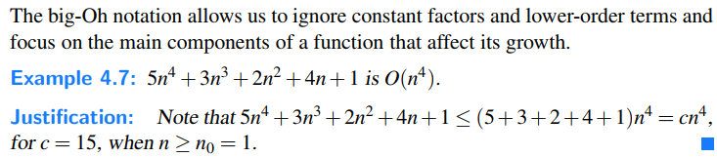
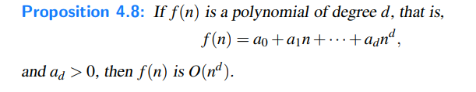
Properties of Big O

Slide 64
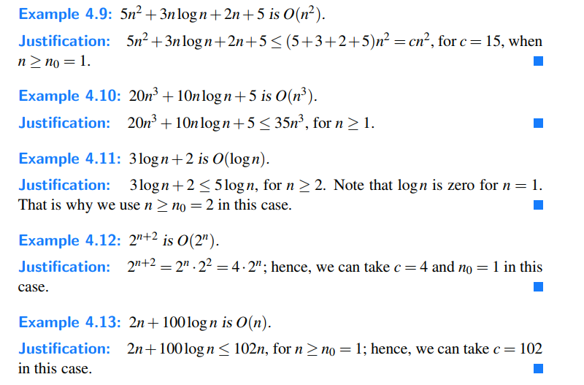

Slide 65
Thank YOU

